Slide 1
eSignature Solution
Aug 11,2015

Slide 2
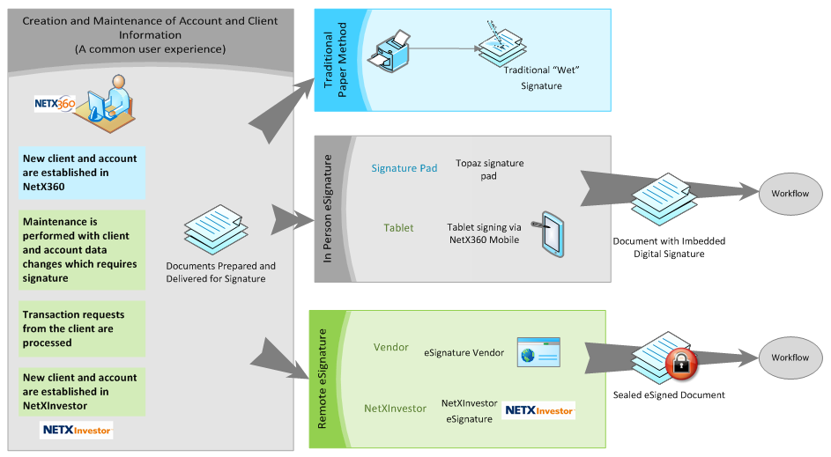
eSignature Solution Highlights
The solution will allow documents to be signed electronically using signature pads.
This solution addresses the need for electronic signature solutions form our broker dealers.

Slide 3
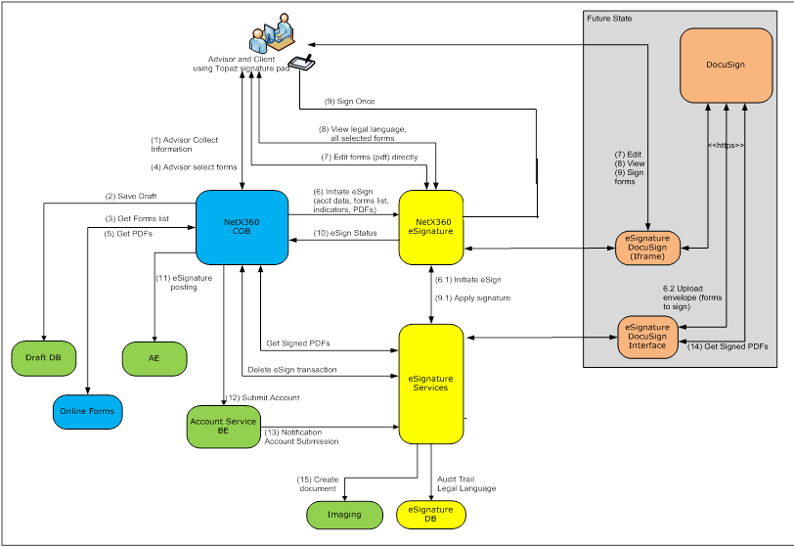
eSignature Process Flow

Slide 4
Projects – eSignature
COB MI
COB 2.0 Account Funding
SIGNiX
NMIS DocuSign
Genesis eSignature

Slide 5
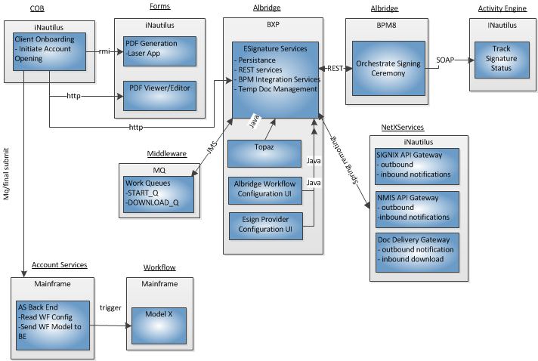
Future eSignature Solutions – Signix and DocuSign
Business Context

Slide 6
eSignature Features
eSignature configuration – If an IBD has signed for a particular eSignature method.
eSignature Validations – For ex number of account holders allowed in an account.
Authentication Methods – SSN, email.
Common framework to enable easy onboarding of new eSignature vendors.
Imaging workflow.
Mixed mode signature with Genesis.
Handling of edits/non edits.

Slide 7
Day1 Screen Layout for Signix

Slide 8
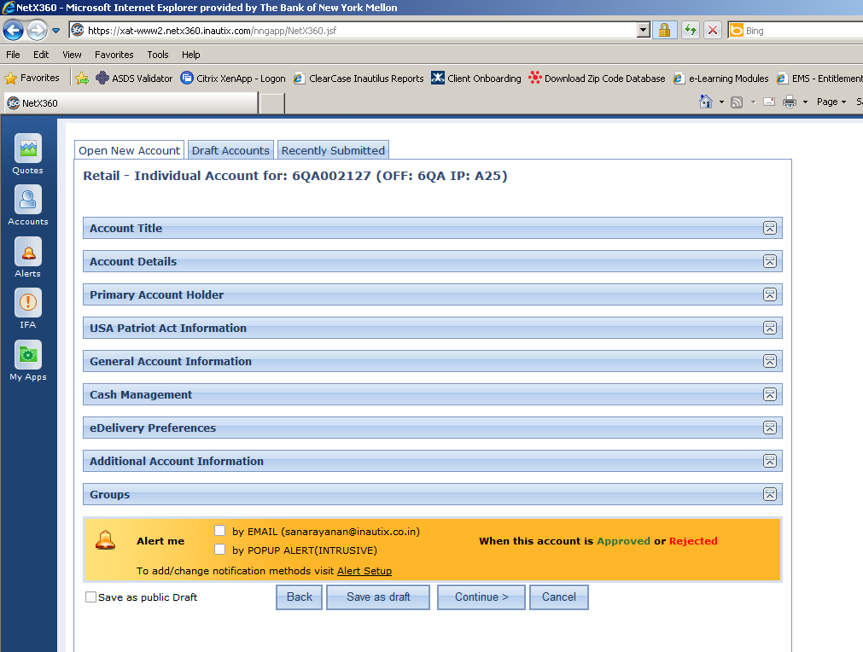
1. Account Opening 1.1 Initiate Account Opening
Day 1: No work for Day 1. For Day 2, “Continue” button will have to be enhanced for COB 2.0

Slide 9
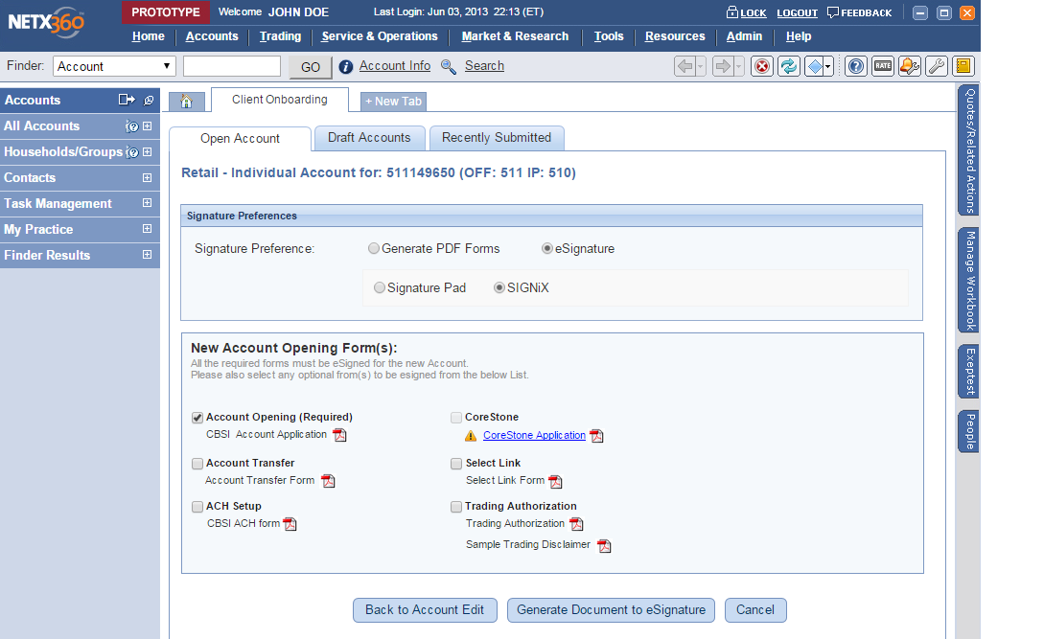
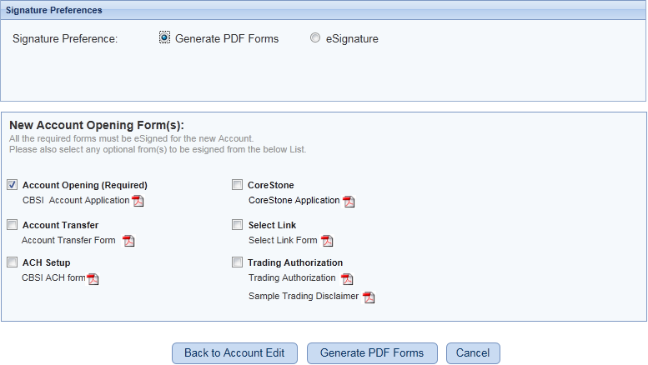
1. Account Opening 1.2 Rep chooses Signature preferences
Pending Processing | Signature Required
Takes you to Validation -> Forms Review & Edit
Takes you to Forms Review
COB needs to build a screen that combines choosing a signature preference and selecting forms to generate
eSignature option: It will show “SIGNiX” and “Signature Pad”. COB Dev: This will be enabled for IBDs who have signed up for eSignature (Ex. W&R for Day 1). Corner Stone will be disabled. For Topaz only clients, the radio button will show “Signature Pad” - revisit. Day 2: PAS has a need for multiple signature vendors. Configure at the office level
Generate PDF Forms option: You can generate PDF forms from here

Slide 10
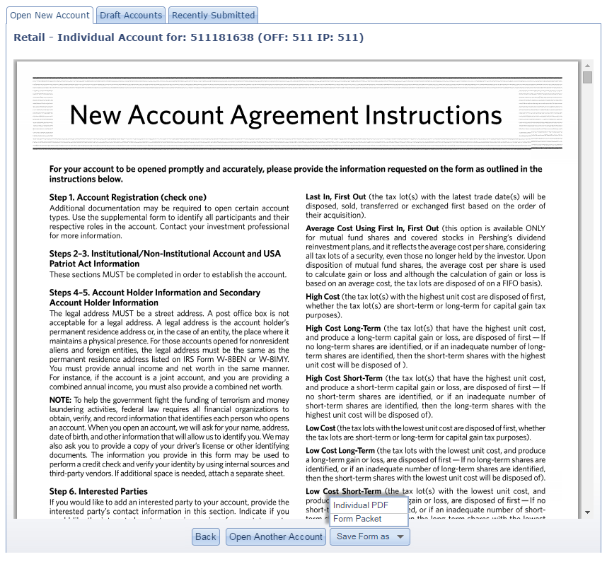
1. Account Opening – From Generate PDF Forms 1.3 Forms Review: Ability to download individual forms or as a packet
Forms needs to provide this functionality. This is for “Generate PDF Forms” option only.

Slide 11
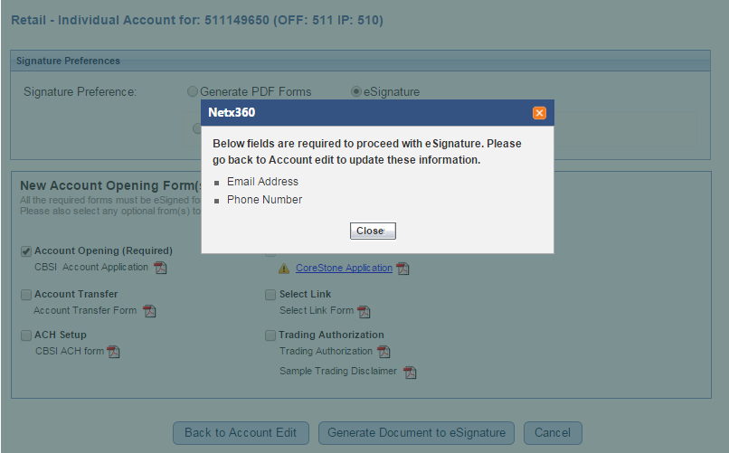
1. Account Opening – From Generate eSignature 1.4 Forms Review and Edit: Mandatory Fields Validation
COB needs to add validation for eSignature process (for ex. Verifying if client email address was entered or any data point required for eSignature option). Show the Rep what is missing and ask the Rep to go back to COB screen so that the info is persisted. There is a possibility that there are additional rules / configuration that makes eSignature an invalid option.
Control is transferred to eSignature service at this time. User info, URL for confirmation page etc. will be transferred.
Cancel transfers the control back to the Signature Preferences page.

Slide 12
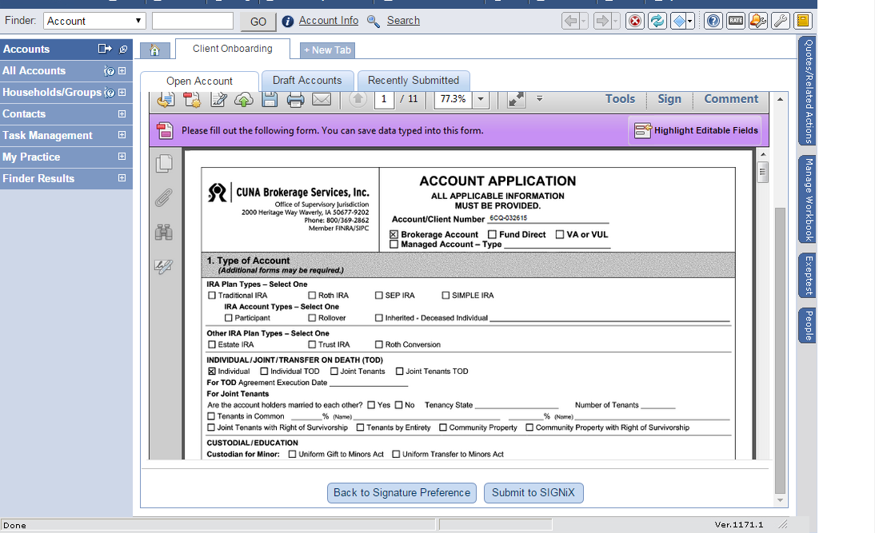
1. Account Opening – Forms Edit and View 1.5 Rep can edit non-COB fields and this doesn’t update any source system
Pending Review | Awaiting eSignature
Possible Forms development for Day 1 SIGNiX clients. Assumption here is that the same forms will be used for eSignature and Topaz. No Cancel button.
Imaging service starts signing ceremony upon submission. Within the same envelope, we send account opening transaction along with optional forms that need to be considered as separate transactions on the SIGNiX side. Needs to be discussed with Forms/Imaging teams

Slide 13
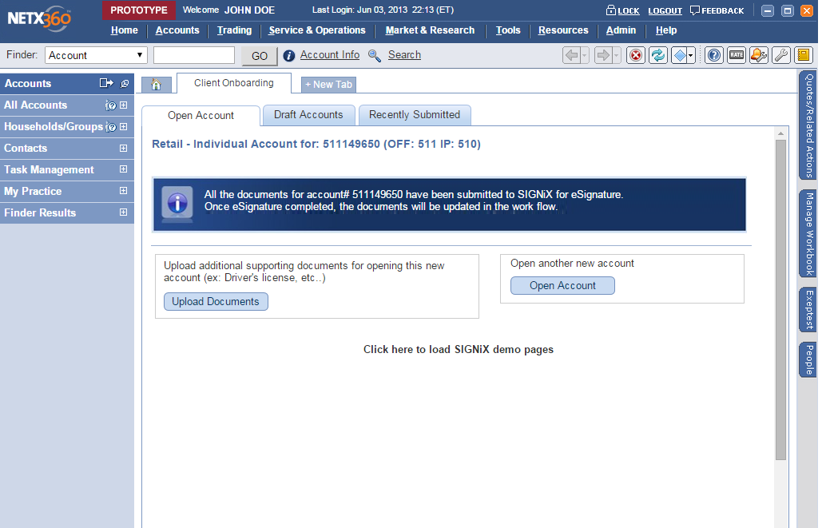
2. Account Opening – After submission Confirmation page
Pending Review | Awaiting eSignature
A/S makes an AE entry for moving the Account transaction to “Pending Release”.

Slide 14
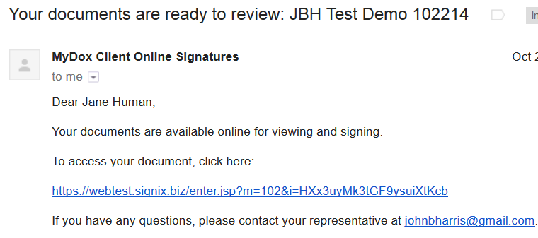
3. Signing Ceremony Email to client + Client consent
For Day 1, SIGNiX sends over the eSign consent and this will be part of Audit Trail. This will be done by the Imaging service

Slide 15
Day2 Screen Layout for Signix/DocuSign with COB 2.0

Slide 16
2. Account Opening Initiate Account Opening
Day 1: No work for Day 1
#1 Initiate Account Opening

Slide 17
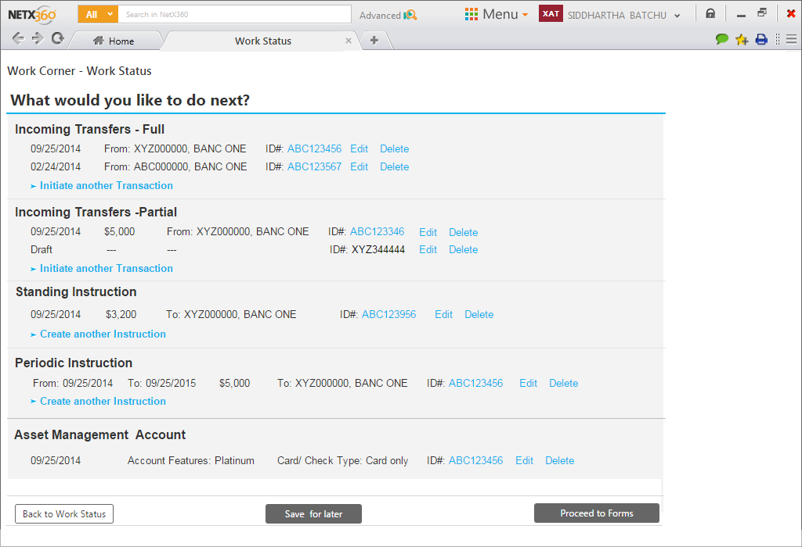
#2 What would you like to do next?

Slide 18
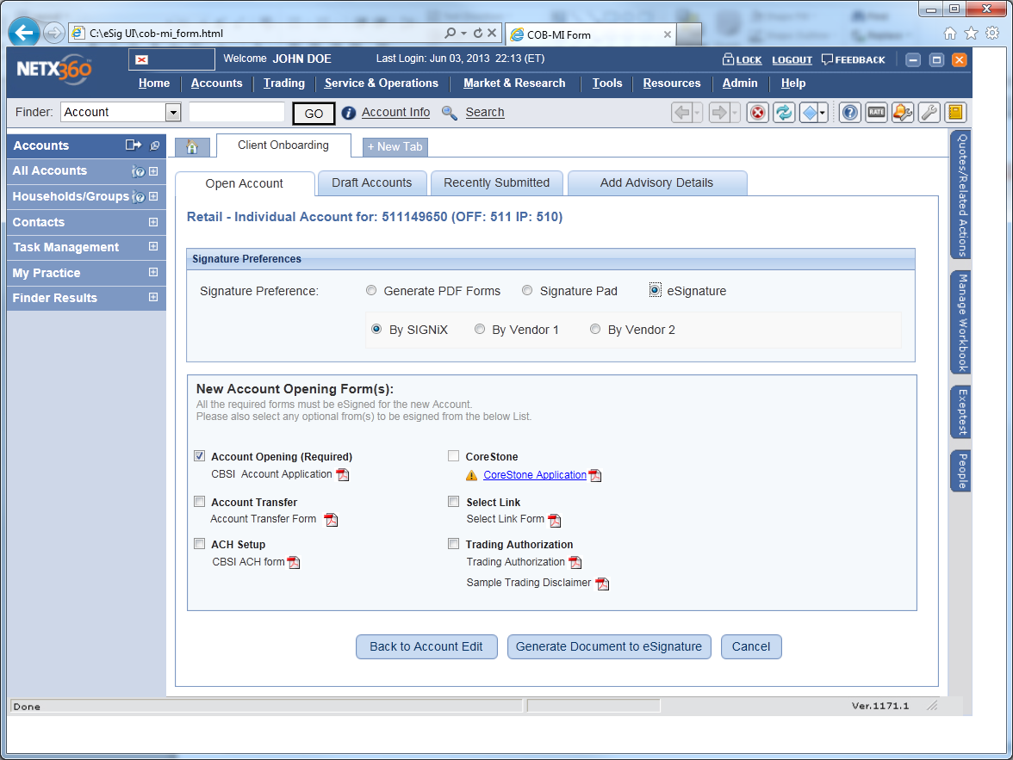
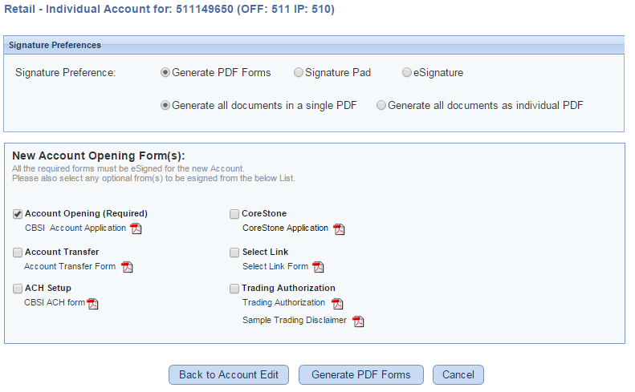
2. Account Opening Rep chooses Signature preferences
COB needs to build a screen that combines choosing a signature preference and selecting forms to generate

Slide 19
1. Account Opening – From Generate eSignature 1.4 Forms Review and Edit: Mandatory Fields Validation
COB needs to add validation for eSignature process (for ex. Verifying if client email address was entered or any data point required for eSignature option). Show the Rep what is missing and ask the Rep to go back to COB screen so that the info is persisted. There is a possibility that there are additional rules / configuration that makes eSignature an invalid option.
Control is transferred to eSignature service at this time. User info, URL for confirmation page etc. will be transferred.
Cancel transfers the control back to the Signature Preferences page.

Slide 20
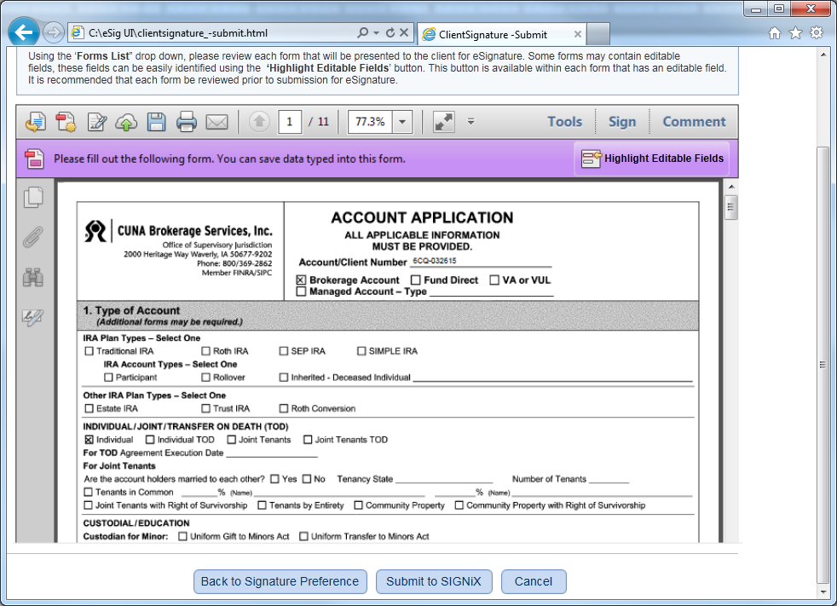
2. Account Opening Rep can edit non-COB fields and this doesn’t update any source system

Slide 21
Screen Layout for Genesis eSignature

Slide 22
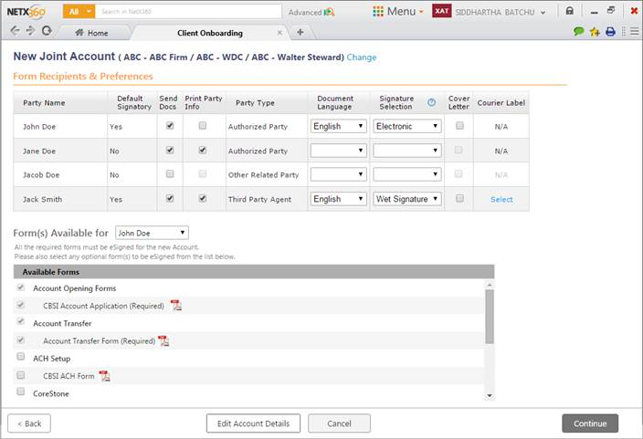
Signature Preferences Screen
Being built for Genesis

